Slide 1

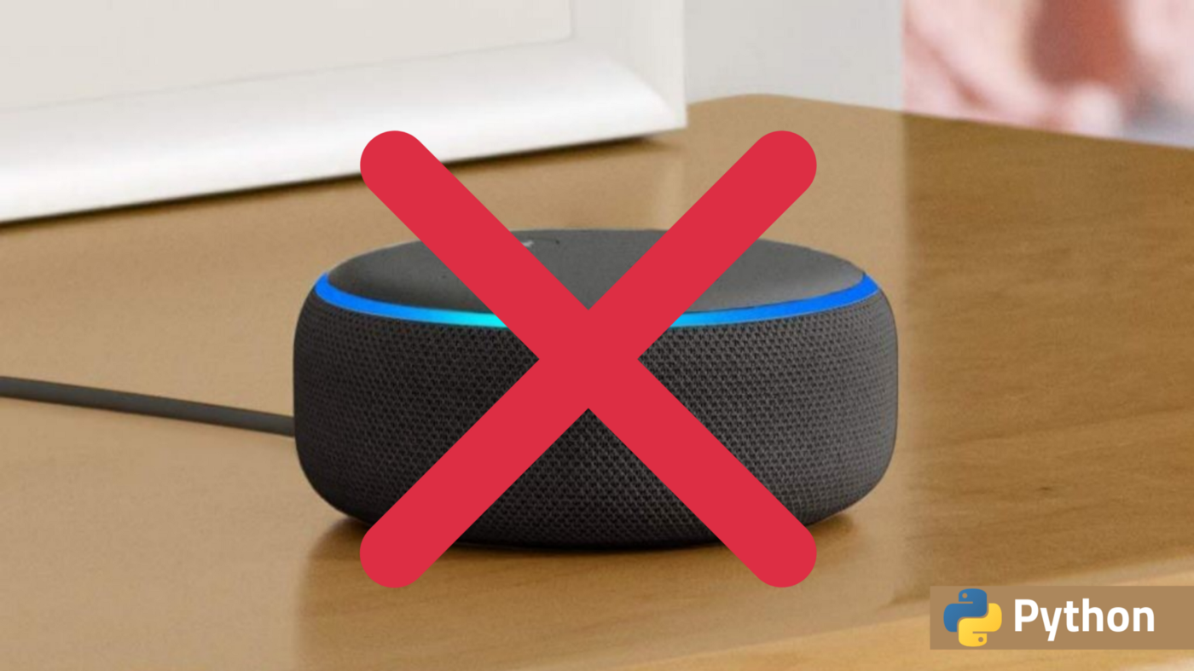
To create a virtual assistant
ASSIGNMENT
Made by:- YUSUF J
Ktc Hubli

Slide 2


Contents
introduction
Basic concept
Working
features
benefits
examples
Advantages
Disadvantages
Steps
Program code

Slide 3
Introduction:-
What is Virtual Assistant?
A virtual assistant is a self-employed worker who specializes in offering administrative services to clients from a remote location, usually a home office. Typical tasks a virtual assistant might perform include scheduling appointments, making phone calls, making travel arrangements, and managing email accounts.

Slide 4

Basic consept of Virtual Assistant
The working of Virtual Assistant uses principles like:
Natural language processing
To understand users speech input
Automatic speech recognition
To understand command given by user
Artificial Intelligence
To learn information about behaviour from user and to store it
Inter process communication
To get other software information & applications

Slide 5

Working
The working of Virtual Assistant consists of
Speech to text
Text analysis
Interpret commands

Slide 6
Can play Music and videos
Features of Virtual Assistant:
it answers questions
it can wish you
it can search any thing in google or any
platform
it can set Alarms,Reminders.
Can send messages

Slide 7
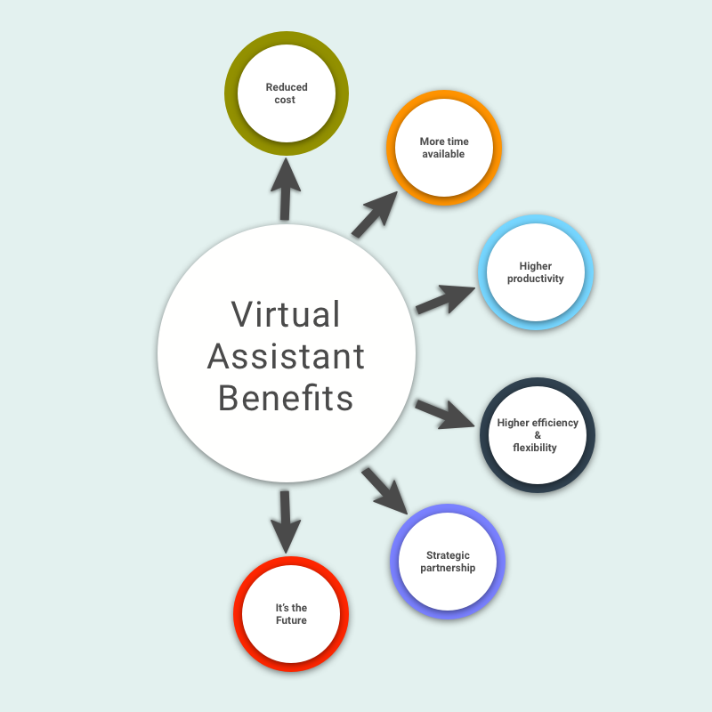

Slide 8
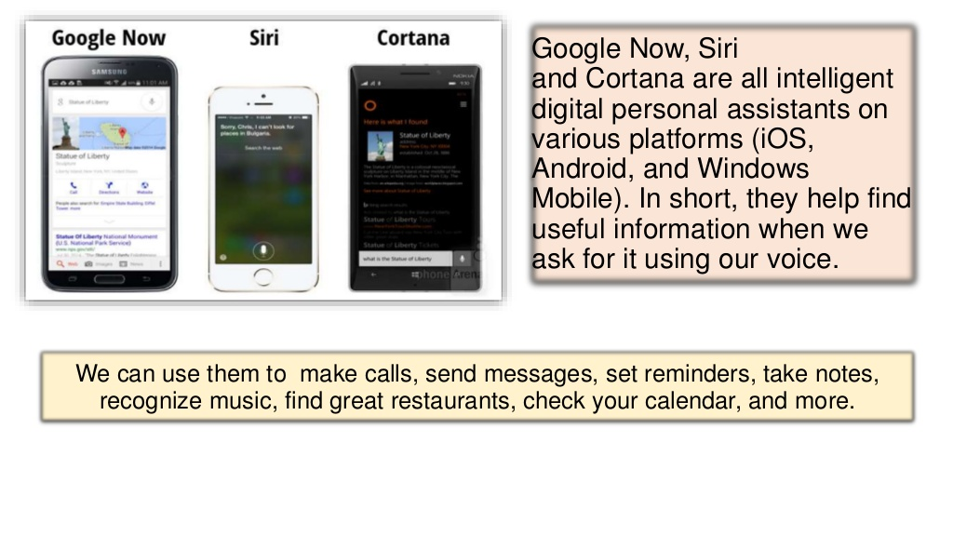
Some examples of virtual assistant

Slide 9
advantages
It allows us to export & import data
it can make lists
it helps to plan the day
It can recognise voice commands
Store various information
They are placed on small hand-held devices

Slide 10
Disadvantages
Some times they have problem to hear wrong
it doesn’t work on DND and silent modes
They always required internet access
Most of virtual assistants understand properly in english language only
While we are talking to each other it takes our talks as a task

Slide 11
Here I have created a virtual assistant by python named Jenny in visual studio code it accepts given command and perform output
Steps and codes for Virtual Assistant is given below:
Yellow colour represents installation setup on the terminal panel/on cmd , to type the given commands in it
Black colour represents the code to be typed in vs code

Slide 12
Steps to create AI
Step 1: install vs.code software,install python 3 & add extention python to vs code
Step 2: on the terminal panel/on cmd ,type pip install pyttsx3
Step 3: open vs code,create new file and type on first line, import pyttsx3
{how many import tasks are present type on top one after another}
Step 4: type, engine = pyttsx3.init('sapi5')
voices = engine.getProperty('voices')
print(voices[1].id)
engine.setProperty('voice',voices[1].id)
{pyttsx3 is a google speech to text engine}
Step 5: you can change voices above: 0 for male voice and 1 for female voice
if you want more voices then you have to download voices
Step 6: on the terminal panel/on cmd ,type 1)pip install win32
2)pip install pyAudio
3)pip install wikipedia
4)pip install SpeechRecognition

Slide 13
Step 7: def speak(audio):
engine.say(audio)
engine.runAndWait()
{type the above statement}
Step 8: def wishMe():
hour = int(datetime.datetime.now().hour)
If hour>=0 and hour<12:
speak("GOOD MORNING SIR!") elif hour>=12 and hour<18:
speak("GOOD AFTERNOON SIR!") else:
speak("GOOD EVENING SIR!")
speak("I am jenny sir how can i help you")
{by this command your Virtual Assistant will wish you based on time and asks how may I help you}

Slide 14
Step 9:
def takecommand():
r = sr.Recognizer()
with sr.Microphone() as source:
print("Listening...")
r.pause_threshold = 1
audio = r.listen(source)
try:
print("Recognizing...")
query = r.recognize_google(audio, language='en-in')
print(f"User said: {query}\n")
except Exception as e:
# print(e)
print("Say that again please...")
return "None"
return query
if __name__=="__main__":
wishMe()
while True:
query = takecommand().lower()
By these commands our VA is ready to hear tasks and wishes you every time you run the program now we can add tasks for our VA to perform

Slide 15
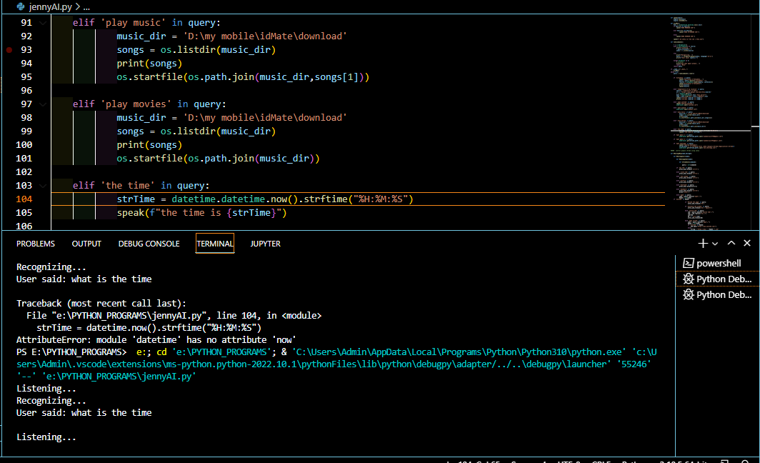
Step 10:
if 'the time' in query:
strTime = datetime.datetime.now().strftime("%H:%M:%S")
speak(f"the time is {strTime}")
This is the time function
Command: what is the time

Slide 16
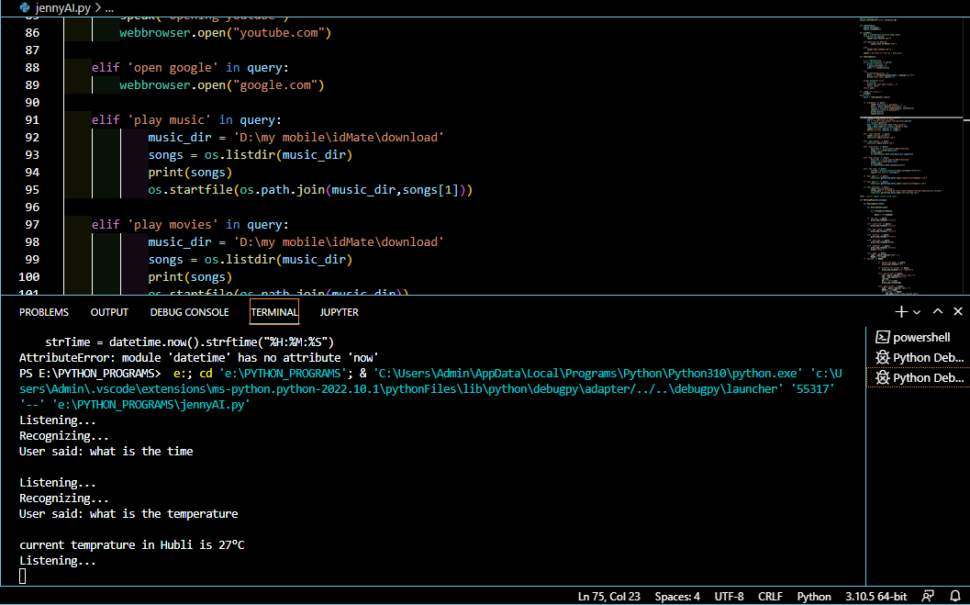
YOU CAN ADD ANY PROGRAMS YOU WANT
Command: what is the temperature

Slide 17
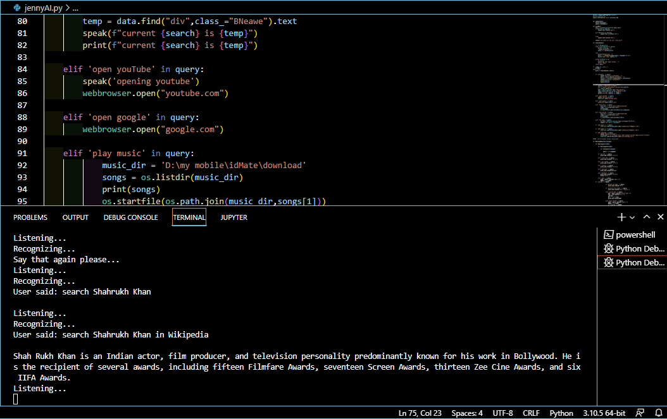
Command: search shahrukh khan in wikipedia

Slide 18
Program code:
Program is on the package given below double click on the program to open code

Slide 19
THANKYOU

